Slide 1
Designing effective chat bots
Christopher Harrison
Microsoft
@geektrainer

Slide 2
Setting expectations
What we will do
What we won't do
Write code
Talk about best practices
Show a few demos
Laugh at bad jokes
Train ML models
Target a specific framework

Slide 3
What is a bot?
Notes:
Given all that, what is a bot?

Slide 4
A bot is not magic
Notes:
In short, a bot is just a type of app.

Slide 5
A bot does not inherently make artificial intelligence easier
Notes:
In short, a bot is just a type of app.

Slide 6
A bot does not inherently make machine learning easier
Notes:
In short, a bot is just a type of app.

Slide 7
A bot is merely an app with a different interface
Notes:
In short, a bot is just a type of app.

Slide 8
Command Line
C:\
Tell me what to do
using a language you don’t know
P.S. I will delete all your files if you get even the tiniest detail wrong.

Slide 9
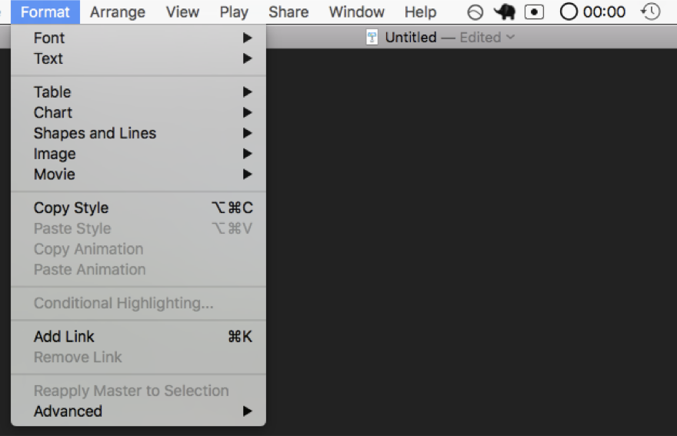
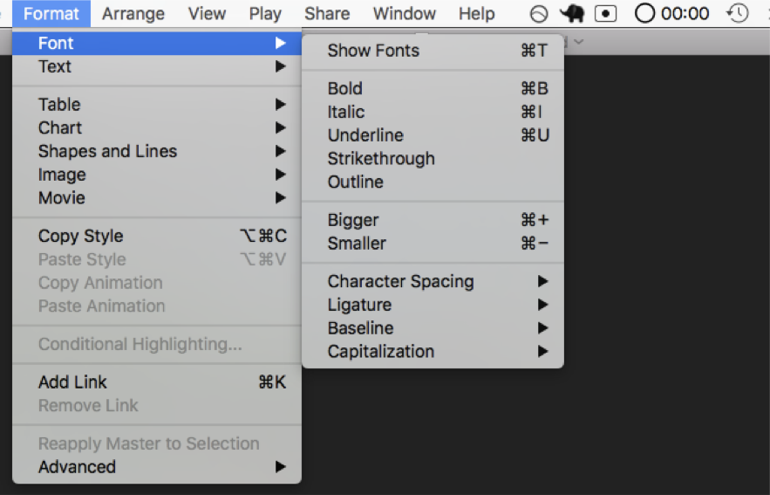
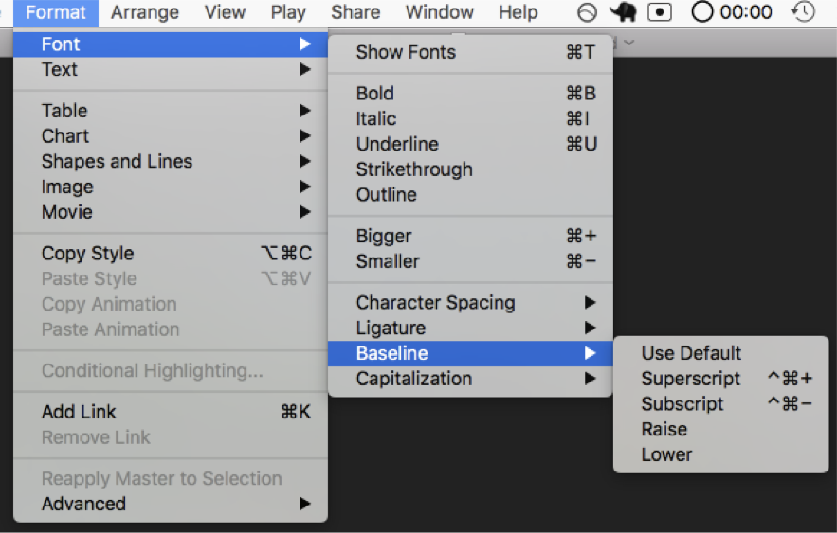
Menus
Select from the following options
So many options
Yo dawg I heard you liked options so here are some options for your options

Slide 10
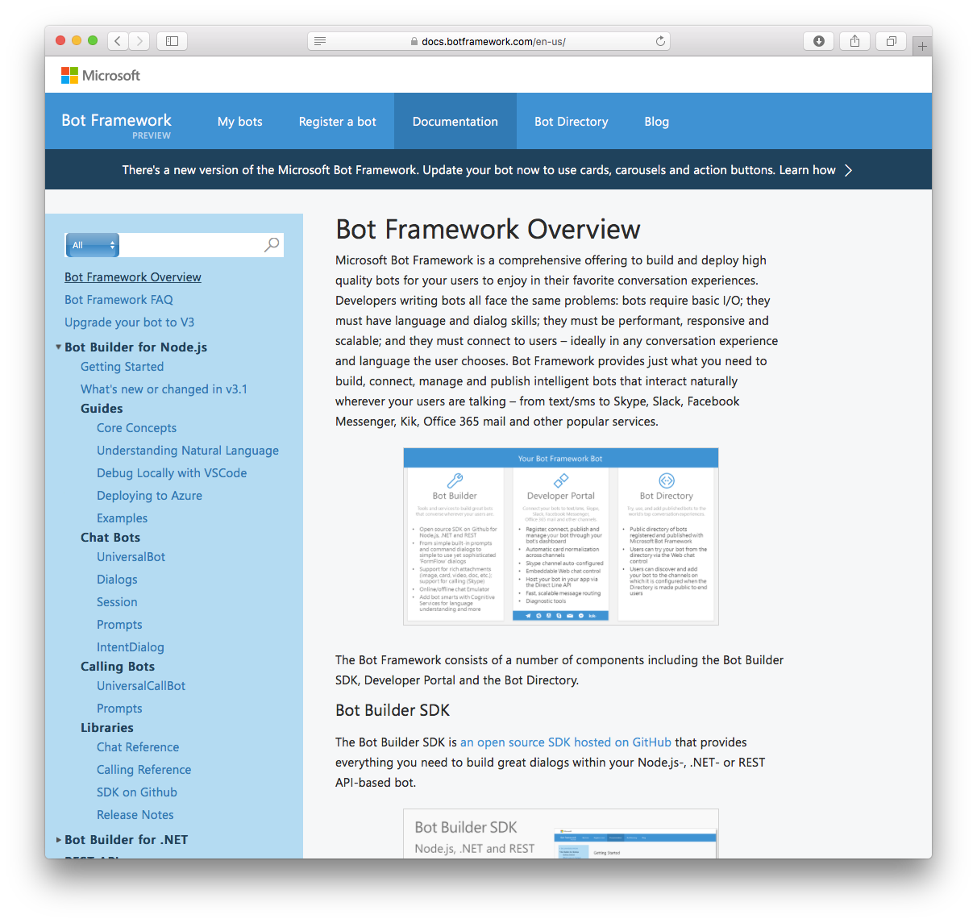
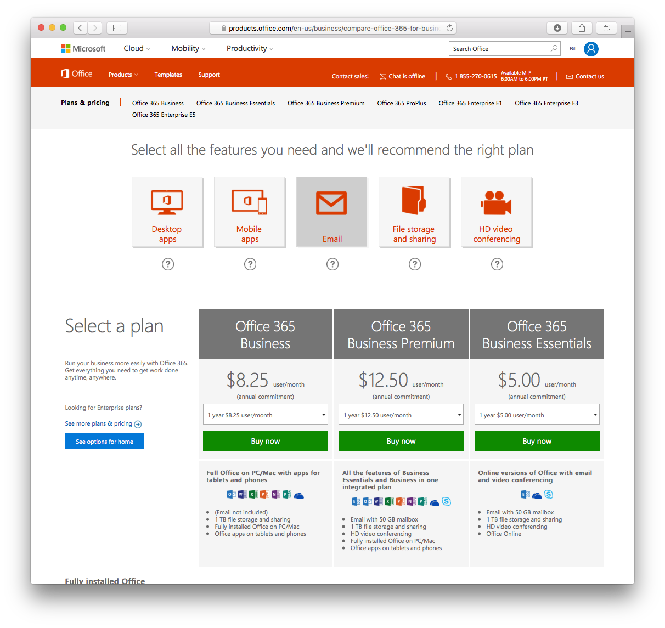
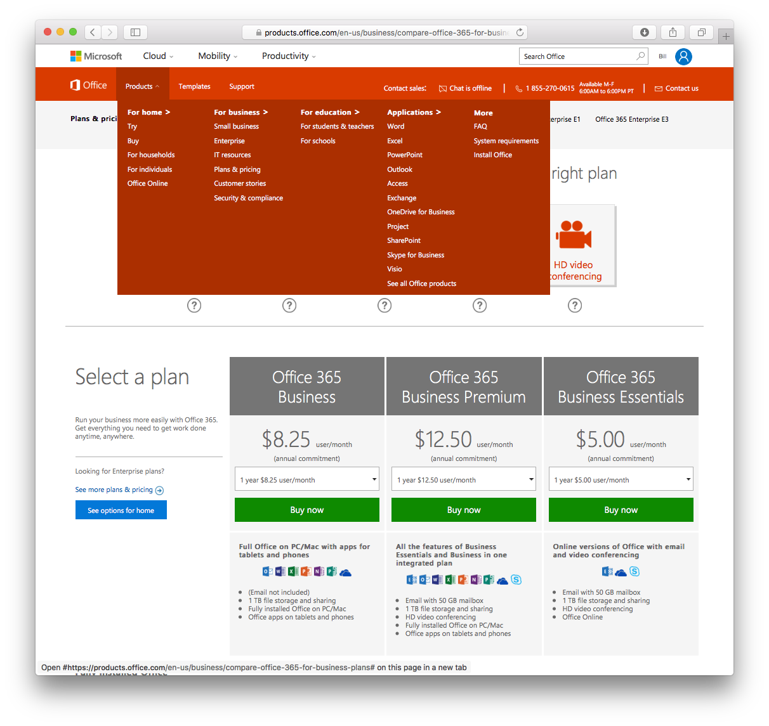
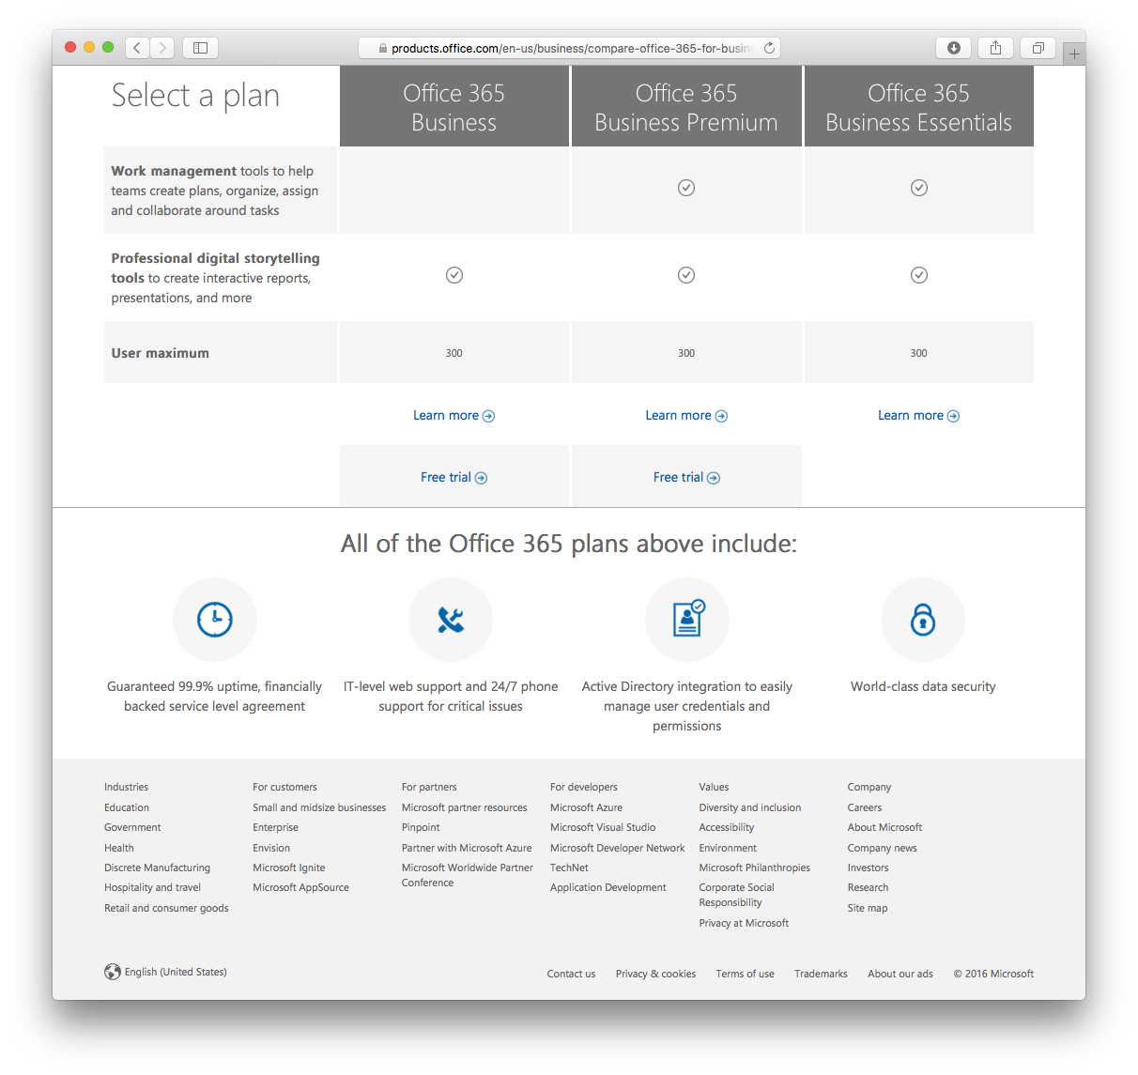
Websites
Good luck finding what you’re looking for.
Keep looking, it’s there somewhere.
Probably.
Start over again with the next website.

Slide 11
I'd like to search for a restaurant.
Sure thing! In what city did you want to search?
San Francisco
What type of cuisine?

Slide 12
Do you really need a bot?

Slide 13
Where do bots shine?
User convenience
Proactive messaging
Help desk
Search

Slide 14
User experience concepts

Slide 15
Give the user a clue

Slide 16
Interacting with the user
Always reply when the user sends a message
Over-index on guidance
Support the obvious commands
Use rich media

Slide 17
Pattern: Menu breakdown
Hello user! How can I help you?
What events are you interested in?
What music would you like? (by the way, next time you could just type “I’m looking for a song named xyz” and I will know what to do)
Events
Music
Stages
Comedy
Amenities
Film
Laser Dome
Spectacles
Theater
Guide the user
Channels often offer specialized menus, quick actions, etc.
Help the user discover what your bot can do
Read more

Slide 18
Who's got the button?
Buttons on cards may be in the chat history
Quick/suggested actions disappear after single use

Slide 19
Where was I?

Slide 20
Be careful about interrupting the user
Provide context
What's the user doing?
Last message timer
Allow proactive messages state option
Be overly descriptive

Slide 21
Incorporating AI & ML

Slide 22
A bot does not need AI, ML or any other TLA
Notes:
In short, a bot is just a type of app.

Slide 23
Adding natural language processing (NLP)

Slide 24









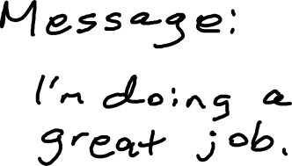

void Send_Click(object s, EventArgs e) {
string contact = txtTo.Text;
string message = txtMessage.Text;
SendMessage(contact, message)
}

Slide 25
Tell Larry that I'm doing a great job.

Slide 26
Intent
Entities
SendMessage(contact, message)

Slide 27
Tell Larry that I'm doing a great job.
SendMessage("Larry", "I'm doing a great job")

Slide 28
Send a text to Larry.
SendMessage("Larry", null)

Slide 29
Send a message saying I'm doing a great job.
SendMessage(null, "I'm doing a great job")

Slide 30
Send a message.
SendMessage(null, null)

Slide 31
Anti-pattern: Overuse of NLP
A bot with using 100 intents is a bad design:
1 question
100 different things your bot can do (intents)
100 different utterances (examples) per intent
= 10,000 different things users may say (plus the other N possibilities you didn’t predict)
Users will only guess a handful
So you might have wasted 90%+ of your training
Hello user! How can I help you?

Slide 32
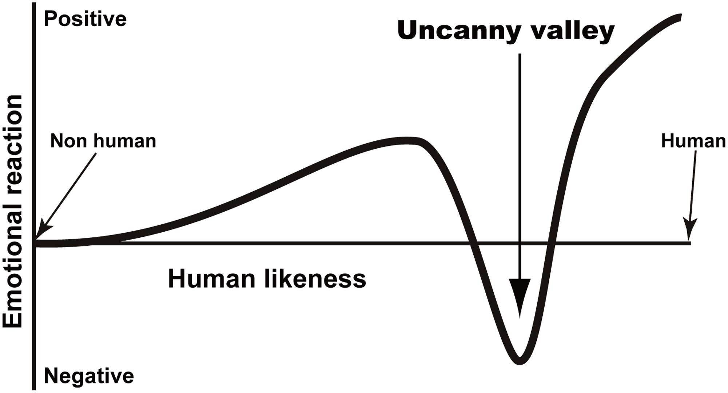
Uncanny valley
This Photo by Unknown Author is licensed under CC BY
Notes:
Draw chart and talk to uncanny valley

Slide 33
Impact of the uncanny valley when building bots
The more your bot pretends to be a human, the more the human will expect
Humans will "down-level" to the bot
Don't try to solve the Turing test
Allow for terse statements
Good for small keyboards anyway
Be clear about what the bot can do
Provide guidance
"You could say ..."
Buttons are a good thing

Slide 34
Improving the experience
Ask for feedback
Train the model

Slide 35

Do you really need speech support?

Slide 36
Using Text Analytics

Slide 37
I need somebody, help!

Slide 38
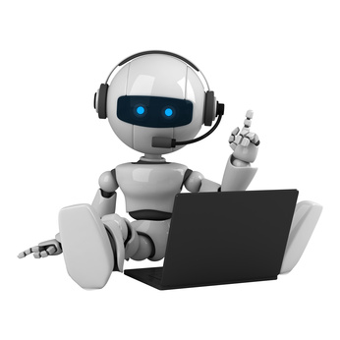



disconnect
agent
#connect
#list
queued

Slide 39
Let me ask someone who knows

Slide 40
What is a bot?
Notes:
Given all that, what is a bot?

Slide 41
A bot is an app with a little more humanity
Notes:
In short, a bot is just a type of app. One that connects to users at a slightly more personal level.

Slide 42
Resources
Bot Framework
dev.botframework.com
Source & samples
github.com/Microsoft/botframework-js
github.com/Microsoft/botframework-csharp
Microsoft Cognitive Services
azure.microsoft.com/services/cognitive-services

Slide 43
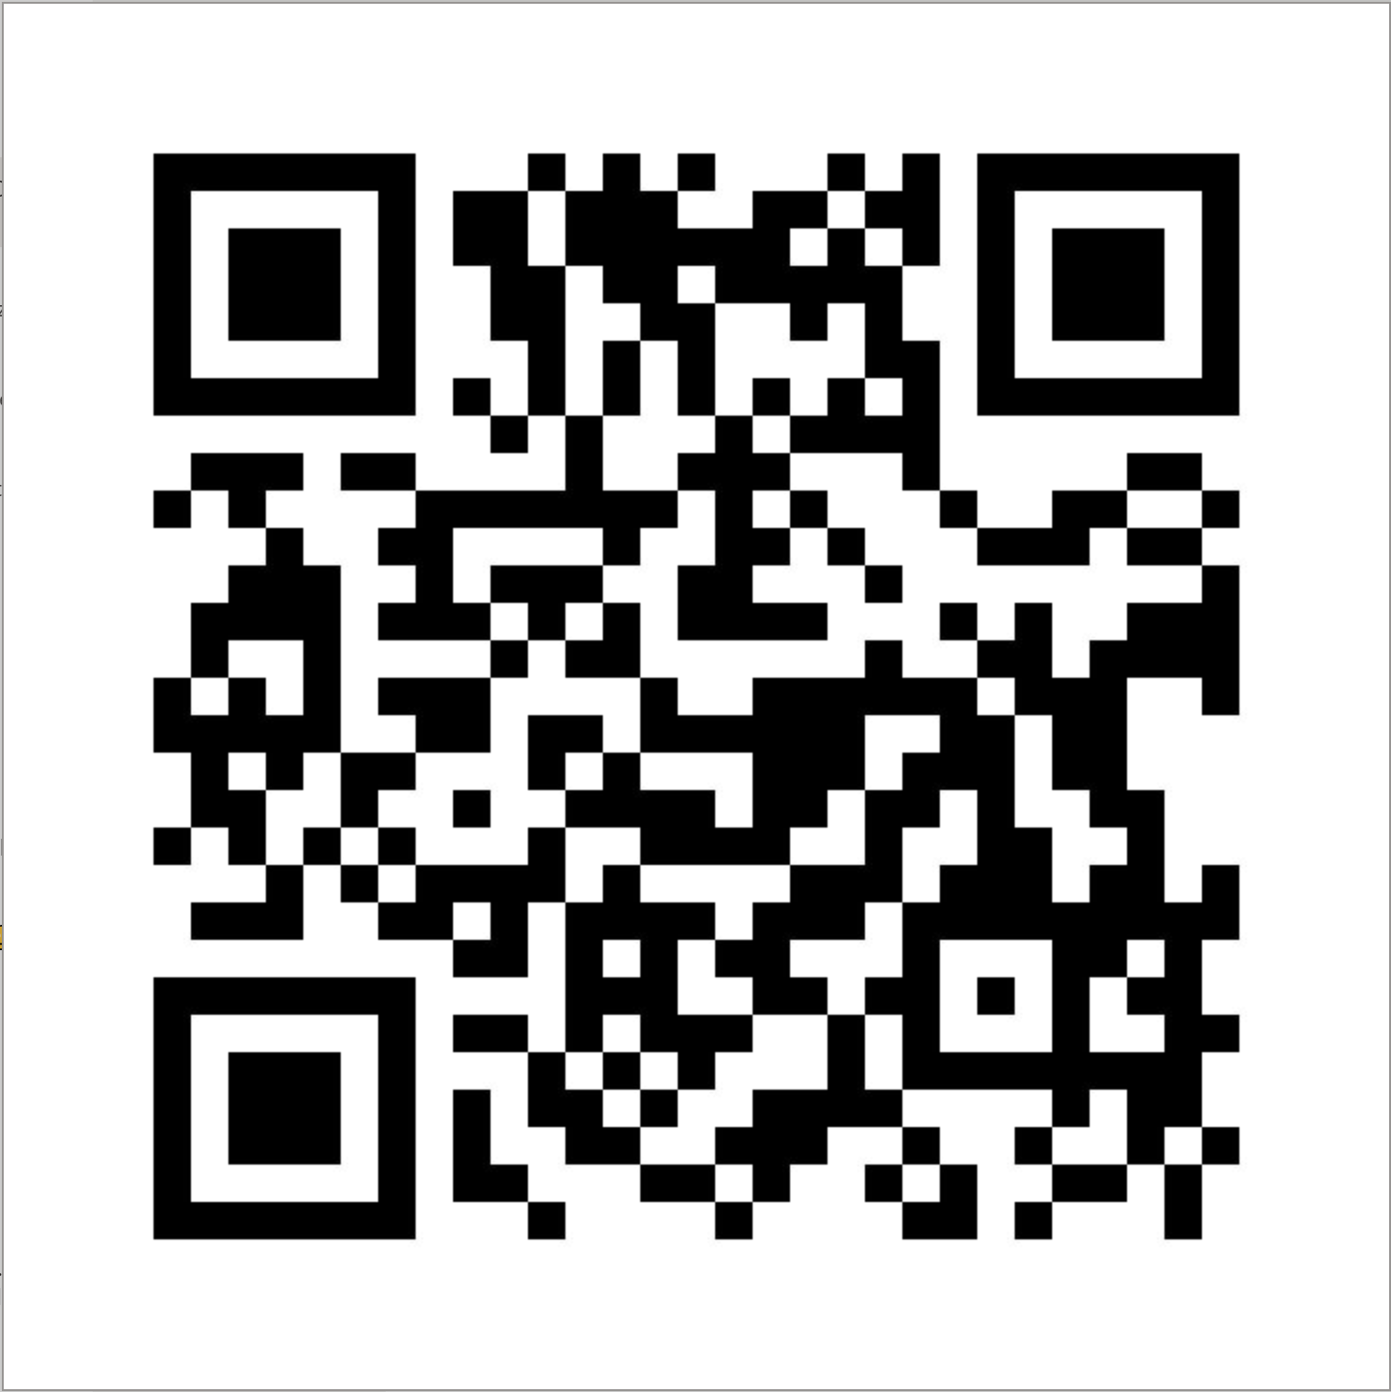
Slide deck and samples
https://aka.ms/AA4jcc2

